Slide 1
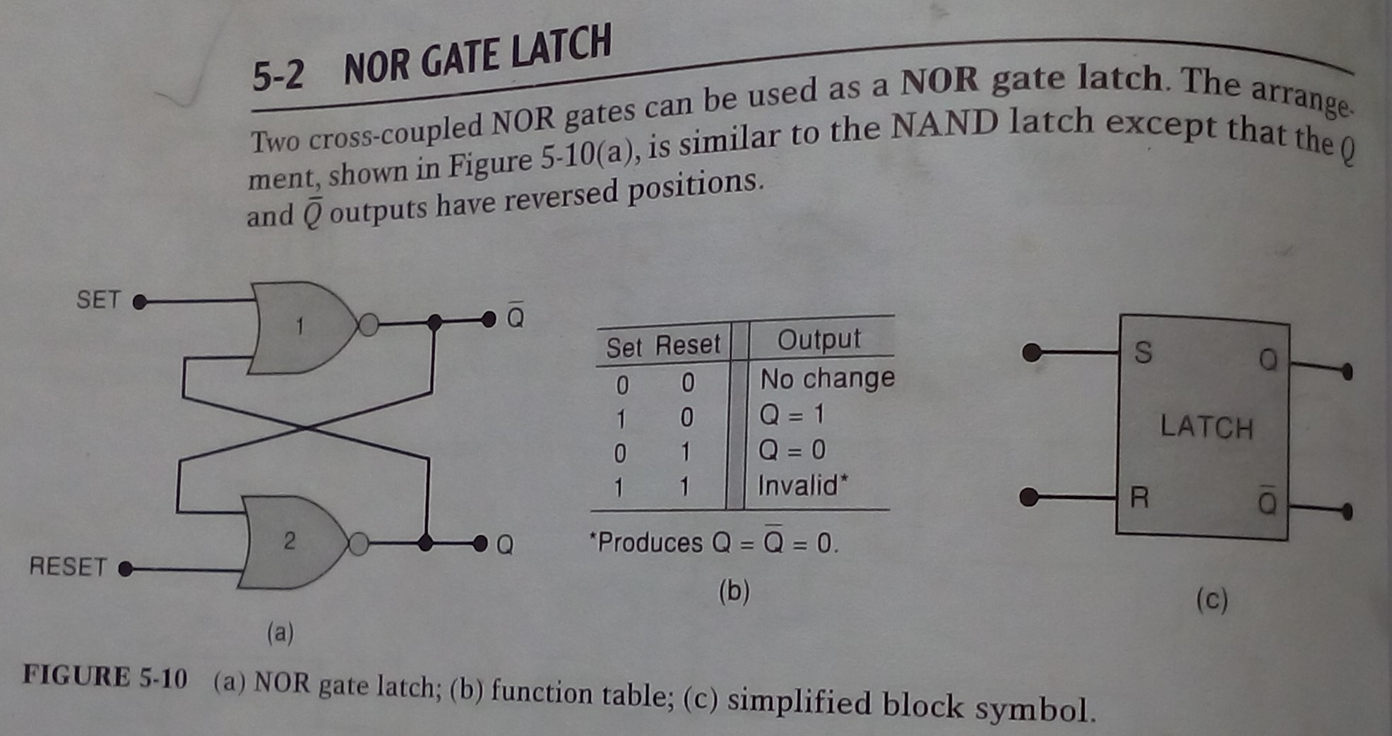
Lecture-15 NOR Latch

Slide 2

NOR Latch

Slide 3

NOR Latch

Slide 4

NOR Latch

Slide 5
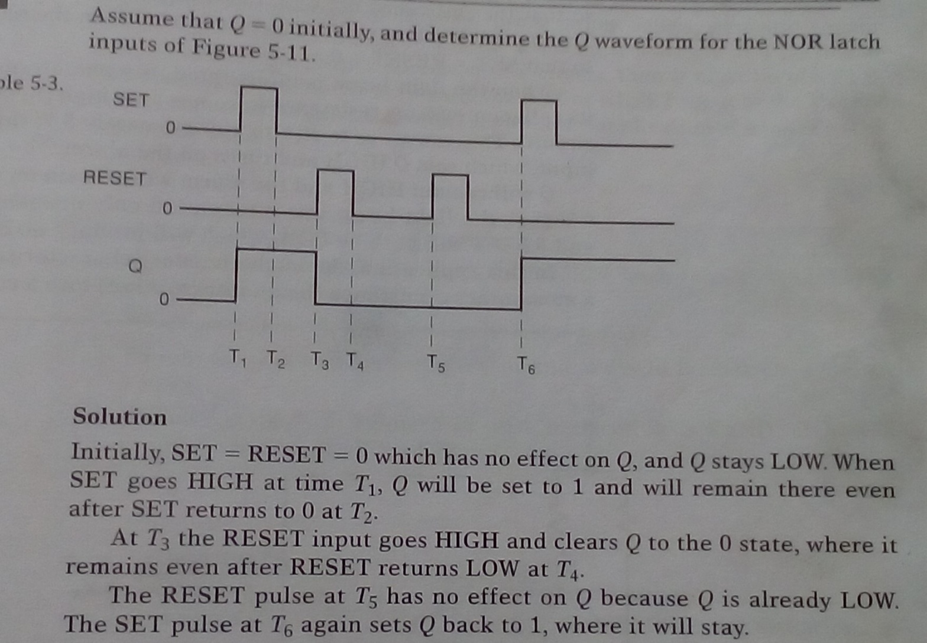
NOR Latch

